Slide 1
AI & ML

Slide 2
Artificial Intelligence

Slide 3
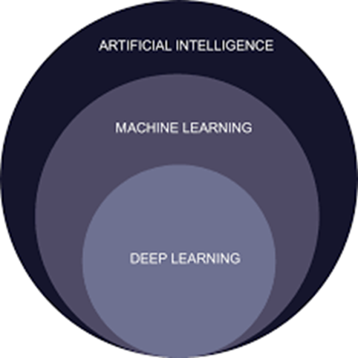
Artificial Intelligence
Artificial Intelligence (AI) refers to the simulation of human intelligence in machines that are programmed to think and act like humans.

Slide 4
Types of AI
AI Types
Capability
functionality
Narrow
Reactive
General
Limit Memory
Super
Theory of Mind
Self Awareness

Slide 5
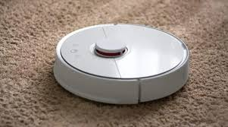
Narrow AI
Narrow AI is also called as weak AI.
The model can perform the only one task which is assigned by the programmer.
Multi tasking cannot be did with this AI where the model will be trained for only one work.
They are not able to learn new things.
Eg:
1.Roomba can only clean the floors they cannot drive a car.
2.Chat bot can interact with persons but cannot clean a room.

Slide 6
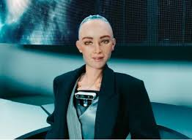
General
This kind of ai are able to do multiple works like driving ,cooking, cleaning etc.
They learn new things from their mistakes
They are also called as strong AI
This kind of AI is under the innovation
Eg:
1.Sophia humanoid robot

Slide 7
Super
Super AI are the robots which have more advanced features then the general Ai.
They are not in reality but can be invented in future
They are not still now invented but they are written as theory
In theory part it is said that they have feelings and emotions

Slide 8
Reactive Machine
Reactive machine is a type of AI which does not have any memory or they cannot store any errors or things .
Reactive machine comes under narrow ai.
Eg: Room cleaning robot, Spam mail , Vending machine etc..
Characteristics of Reactive Machines:
No Memory: They operate solely on the current input and lack the ability to store or use past information or experiences.
Pre-programmed Rules: Their behavior is governed by predefined rules and algorithms, not by learning or adapting.
Specific Task Focus: Reactive machines are designed to perform a single, well-defined task.

Slide 9
Limit Memory
Limit memory is a kind of AI which can store a little amount of data
Limit memory also comes under the narrow ai
Eg: chat gpt, Self driving cars,etc…
Characteristics of Limited Memory AI:
Temporary Data Storage : Limited memory AI systems store information only long enough to complete a task effectively. This contrasts with long-term memory, which can store information for extended periods.
Real-Time Decision-Making : These systems excel at processing and reacting to new information quickly, making them suitable for applications requiring immediate responses, such as autonomous vehicles navigating traffic.
Adaptability : Limited memory AI can adapt to changing situations by incorporating newly acquired data into its decision-making process.
Machine Learning Model: Limited memory AI often relies on machine learning algorithms, such as supervised or unsupervised learning, to analyze data and improve performance over time.

Slide 10
Theory of Mind Self Awareness
Theory of mind comes under the general ai.
They can work in their own and learn new things
Self awareness comes under the super ai
They can work in their own and learn new things
They behave like humans

Slide 11
Machine Learning

Slide 12
Machine Learning Types
ML
supervised learning
unsupervised learning
reinforcement learning

Slide 13
Supervised Learning
This type of learning involves training a model on a labeled dataset, where each data point has a corresponding target or output value.
The goal is to learn a mapping function from inputs to outputs, enabling the model to predict the output for new, unseen inputs.
Examples of supervised learning algorithms include linear regression, logistic regression, and decision trees.
Common tasks include classification (e.g., spam detection) and regression (e.g., predicting house prices).

Slide 14
Unsupervised Learning
In unsupervised learning, the model is trained on an unlabeled dataset, and the goal is to discover patterns, structures, or relationships within the data.
There are not predefined target values, and the model learns to group similar data points together (clustering) or reduce the dimensionality of the data.
Clustering algorithms like k-means and hierarchical clustering are examples of unsupervised learning.
Unsupervised learning is used for tasks like customer segmentation, anomaly detection, and dimensionality reduction.

Slide 15
Reinforcement Learning
Reinforcement learning involves training an agent to make decisions in an environment to maximize a reward signal.
The agent learns through trial and error, receiving feedback in the form of rewards or penalties for its actions.
Reinforcement learning is used in robotics, game playing, and control systems.
Examples of reinforcement learning algorithms include Q-learning and policy gradients.

Slide 16
Machine Learning Algorithm
Supervised
Unsupervised
Linear Regression
Logistic Regression
Decision Tree
Support Vector Machine (SVM)
Naive Bayes
K-Nearest Neighbors (KNN)
Random Forest
Clustering
Association
Dimensionality reduction

Slide 17
Thank You

